Slide 1

5th Gen networking and CPS
Presentation by: Mohamed Amer

Slide 2
TABLE OF CONTENTS
01
02
03
04
05
Introduction to CPS
5G technology overview
Benefits of integration
Applications of CPS and 5G integration
Security Challenges and Vulnerabilities
Research challenges and Projections
06

Slide 3

01
Introduction to CPS
What is a Cyber-Physical System?

Slide 4
Introduction to CPS
Definition: Integrated systems where it contains a physical system and a simulated system. Integration needs computation and communication technologies
Key Characteristics
It is the foundation of IoT and Industry 4.0 and more
It is required to have Real-time monitoring and control abilities
Integrates physical systems with cyber computing

Slide 5
5G technology – The Communication Enabler
02
How 5G technology enabled more advanced CPS systems?

Slide 6
5G technology – The Communication Enabler
Enabling Features:
Ultra-low latency (1-10ms)
High bandwidth and data transfer rates
Massive machine type connectivity
Enhanced mobile broadband (eMBB)
Technological Innovations:
Introduced Network Slicing
Ultra-Reliable Low-Latency communication

Slide 7
5G technology – The Communication Enabler
Ultra-Reliable Low-Latency Communication:
Allowed low latency transmission of small payload with very high reliability
Enhanced mobile broadband: Stable connections with high peak data rates supporting continuous data flow

Slide 8

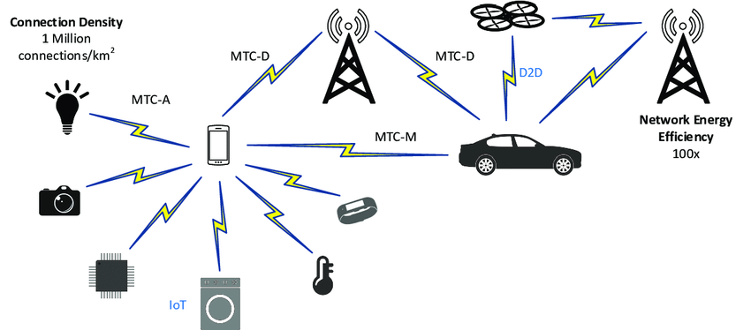
5G technology – The Communication Enabler
Massive machine-type communications: Support for large-scale IoT implementations in smart cities and factories

Slide 9
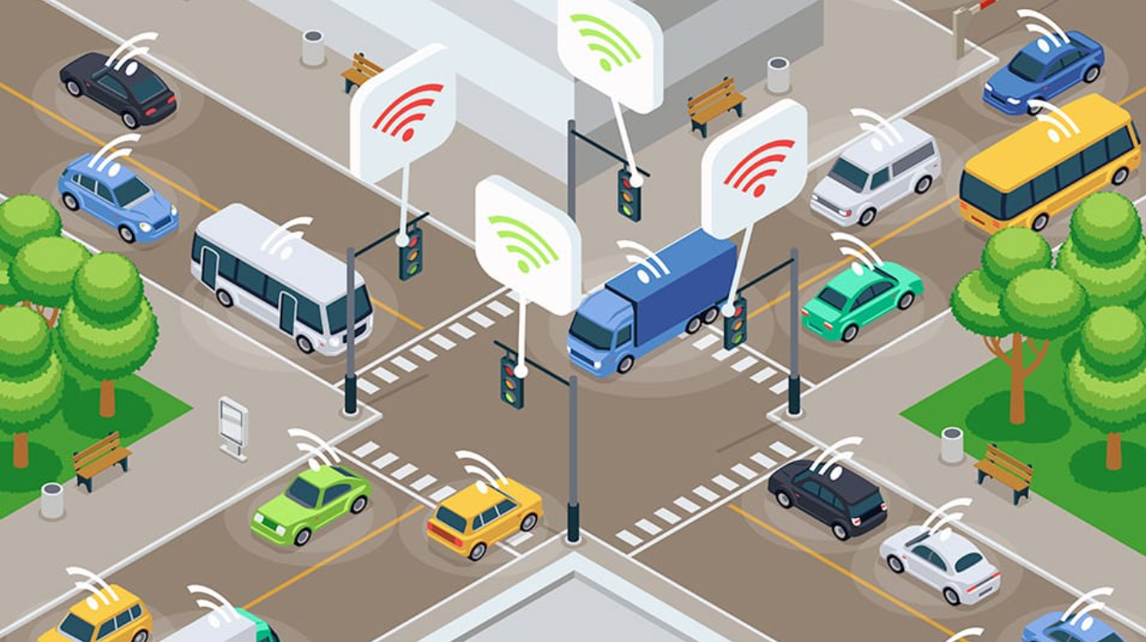
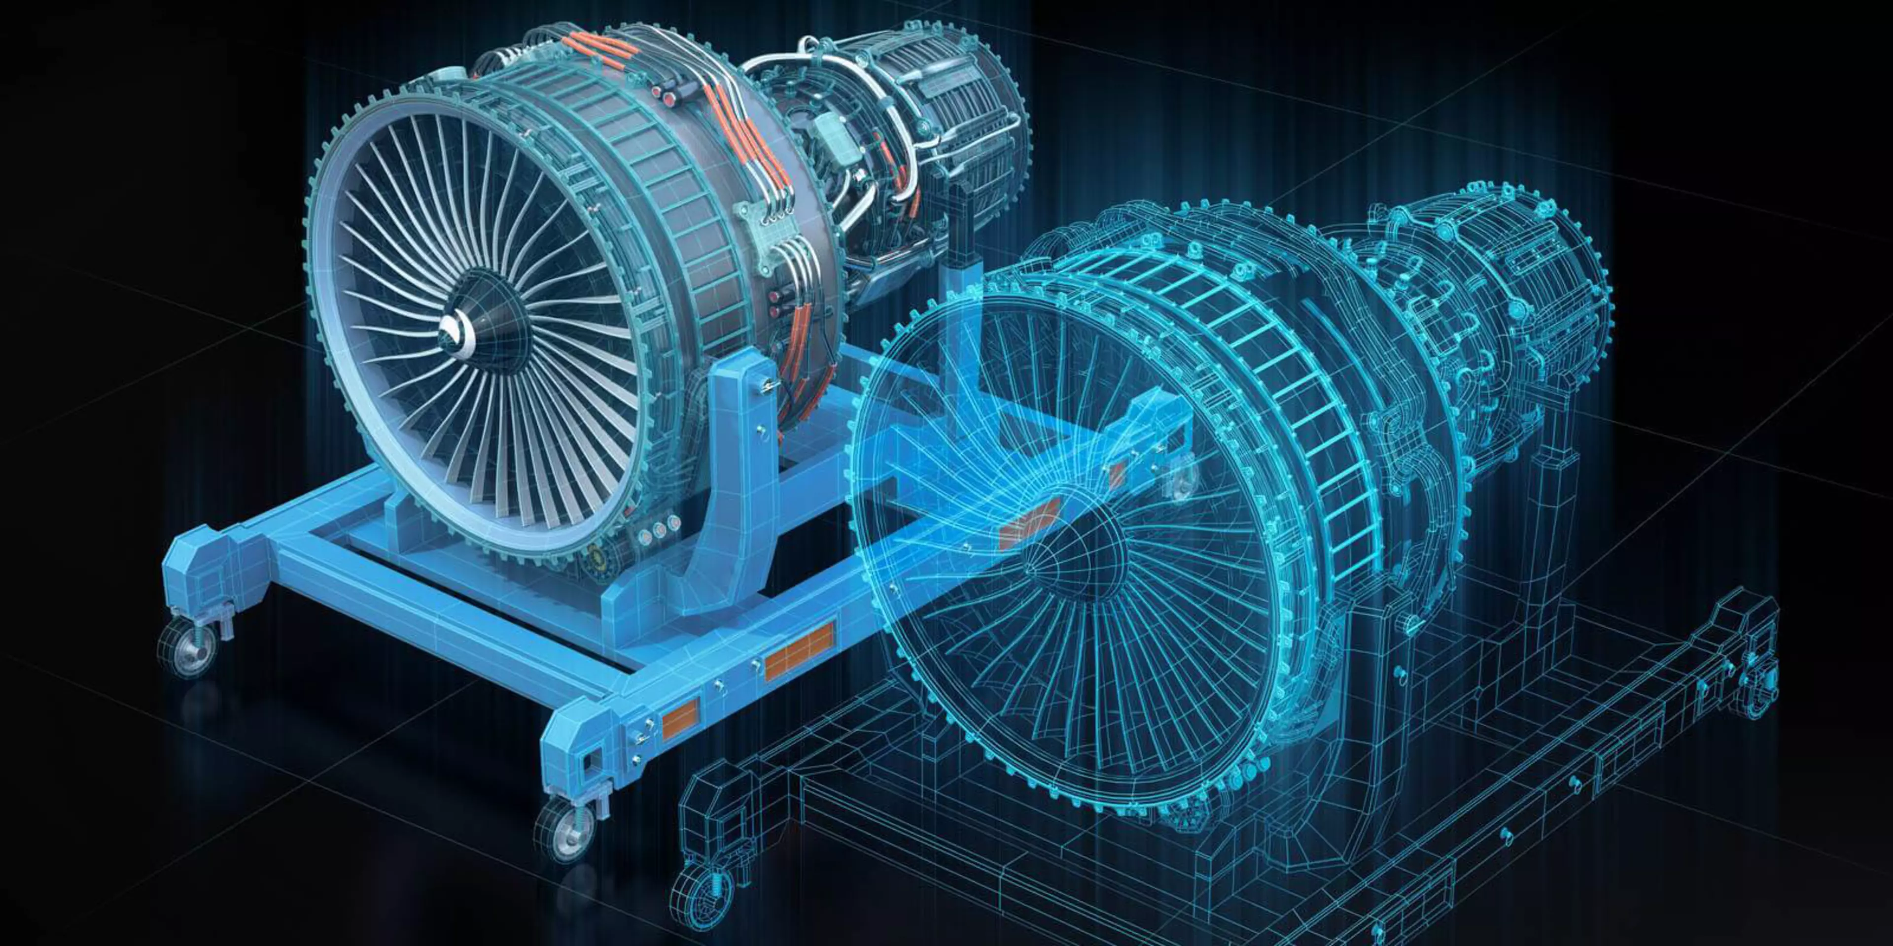
Applications:
03
How can Industries make use of this integration?

Slide 10
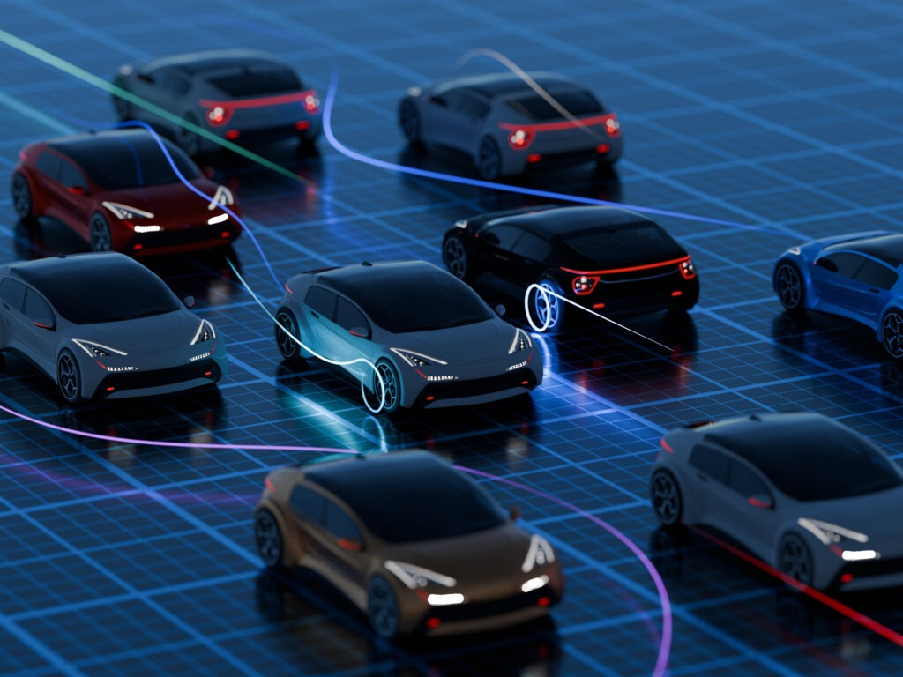
Applications: Smart transportation Systems
Challenge: The rapid growth of automotives and traffic congestions that that classical solutions cannot keep up with.
5G enabled CPS solutions:
Vehicle – vehicle communication with near real-time latency
Real- Time traffic conditions data exchange with path planning
Autonomous congestion avoidance systems

Slide 11
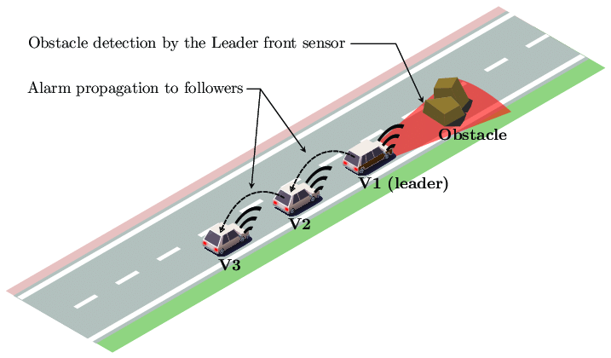
Vehicle Platoon Control
Features:
Provides Fuel Efficiency
Enhances Highway safety
Increasing traffic stability

Slide 12

Applications: Digital Twins
Digital Twins: It is a link between physical and virtual world in cyber-physical production systems

Slide 13
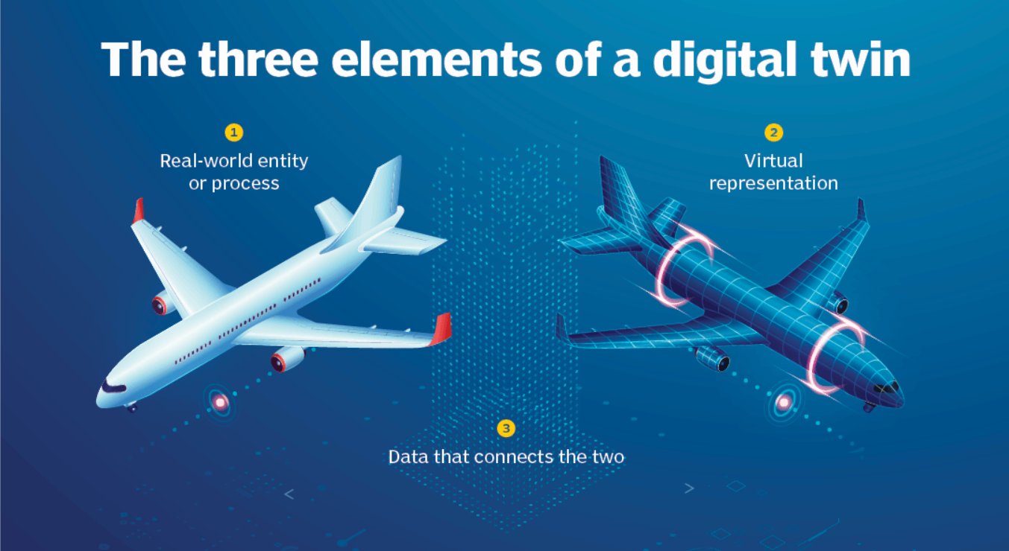
Applications: Digital Twins
Three Interconnected subsystems:
Communication System: Using 5G Network Infrastructure
Digital System: Includes a virtual twin and a simulation analytics software
Real System: Physical Components and sensors

Slide 14
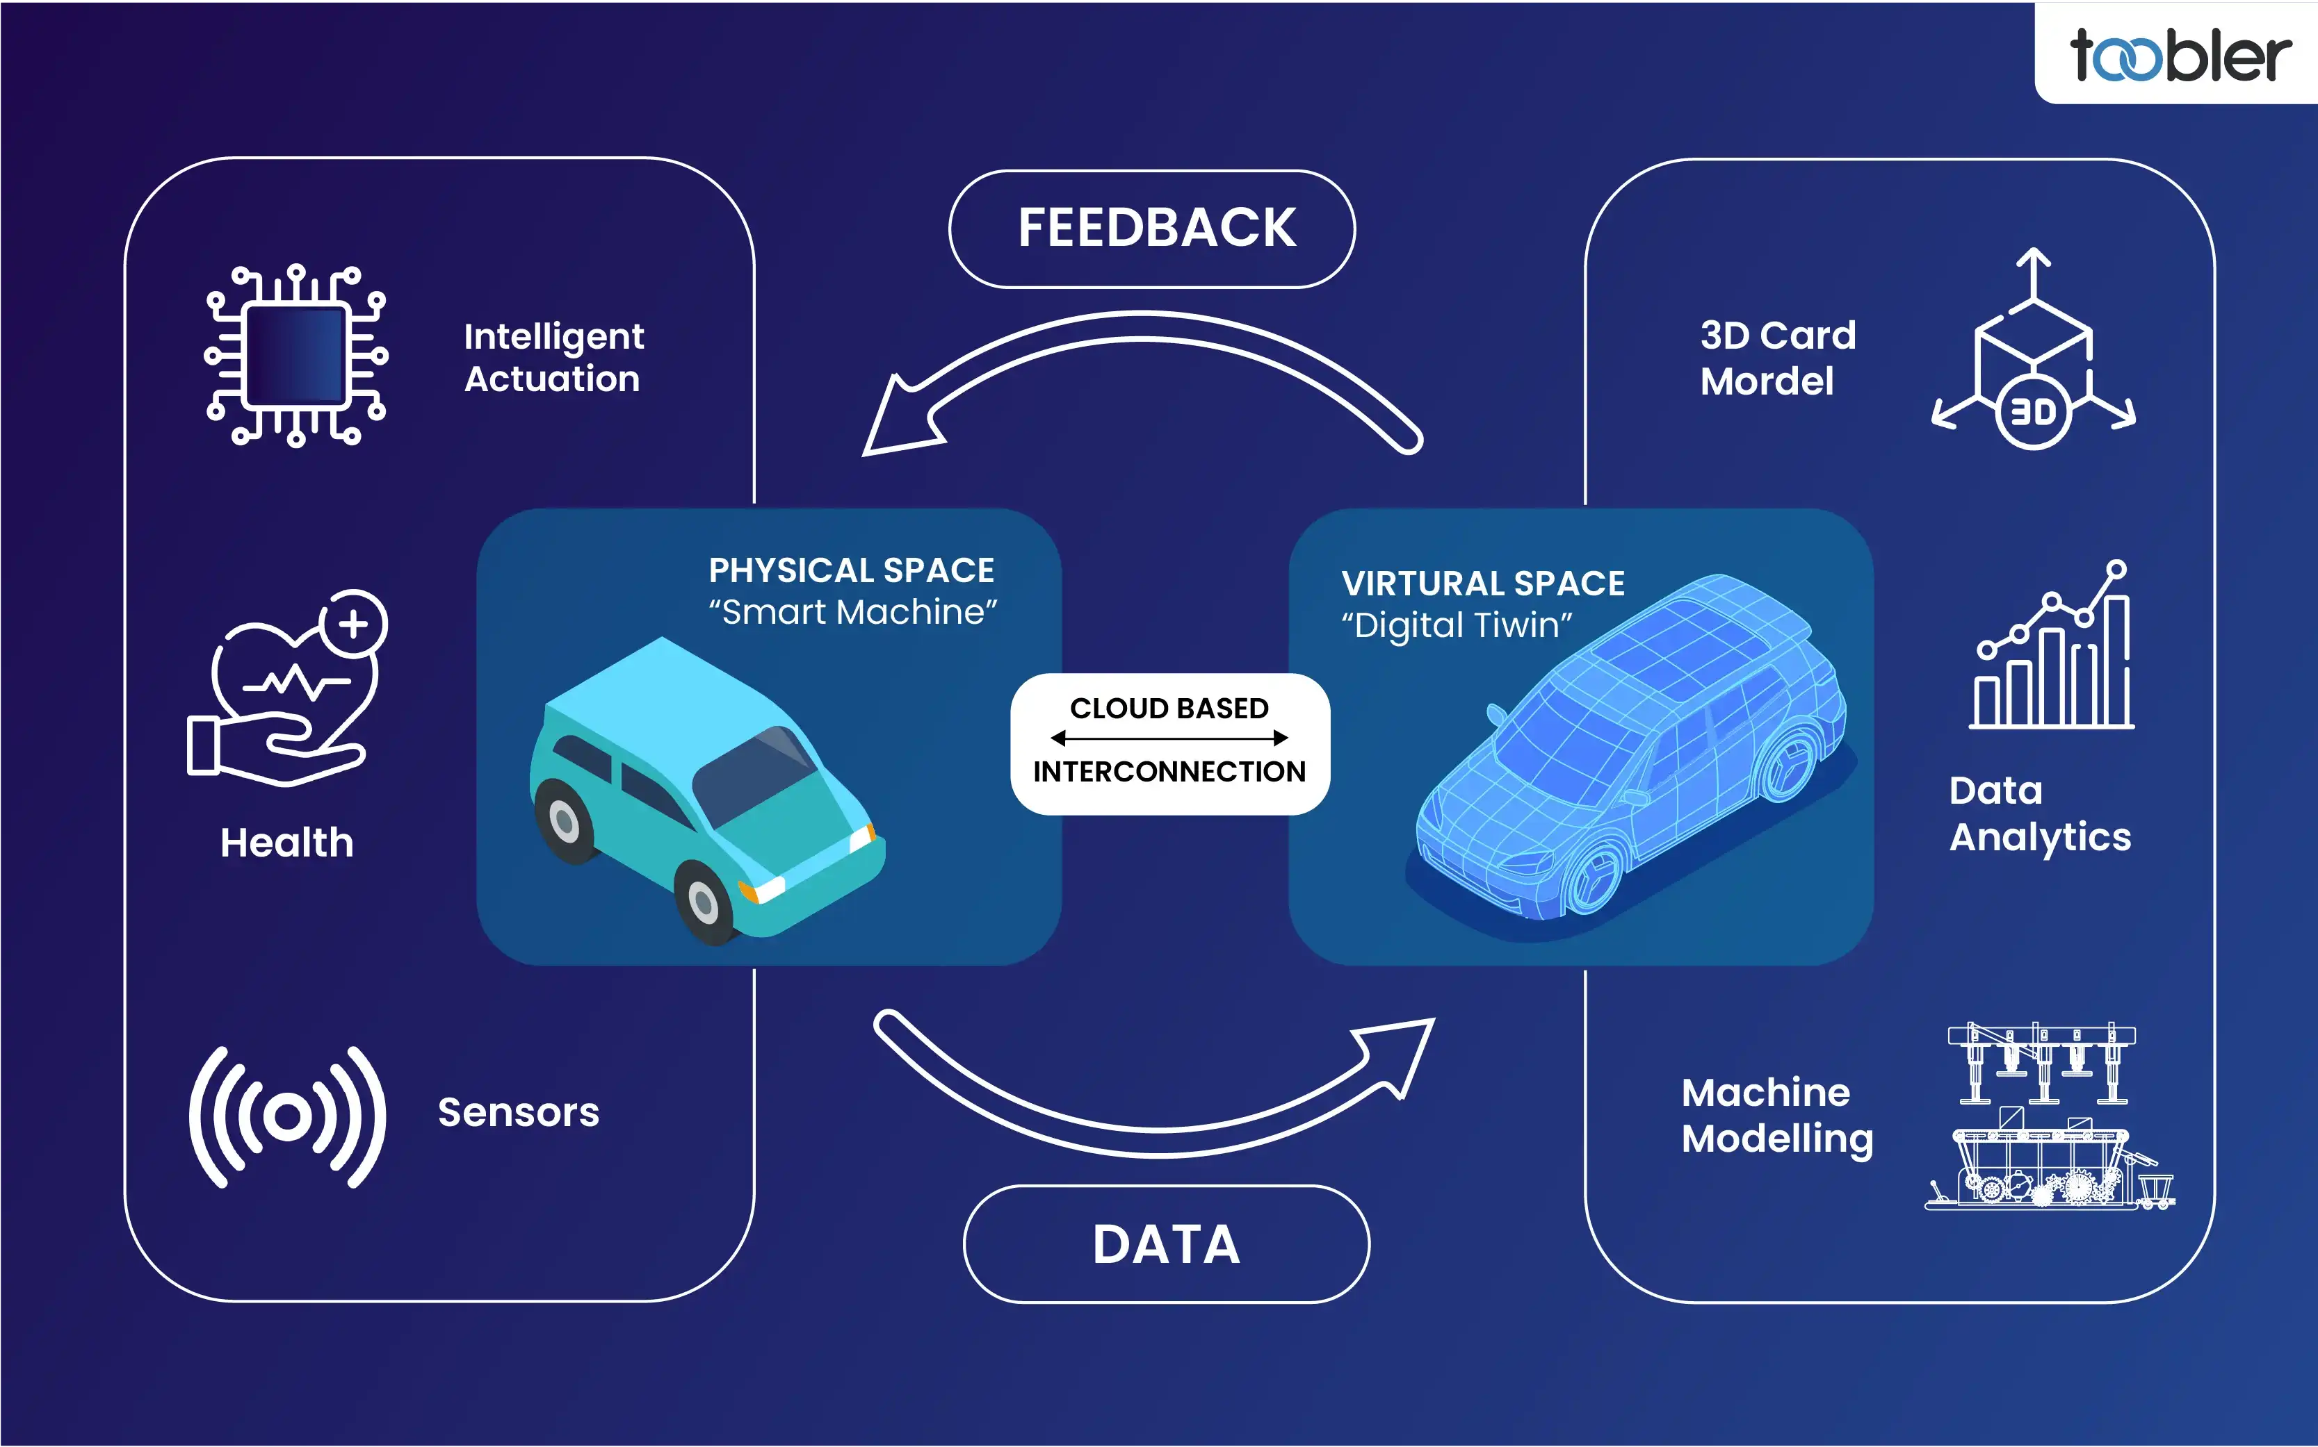
Applications: Digital Twins
Three Main Functionalities:
Prediction: System behavior forecasting without real world implementation
Diagnosis: Historical and real-time failure analysis and explanation
Monitoring and control: Real-time parameter tuning using digital twin data

Slide 15

Applications: Digital Twins
Main System Requirements:
Wireless data transmission
Ultra-low latency not more than 1 ms

Slide 16
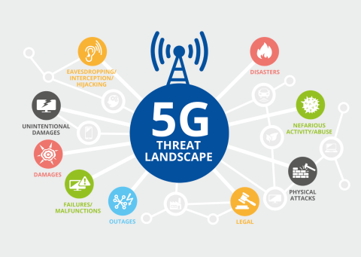
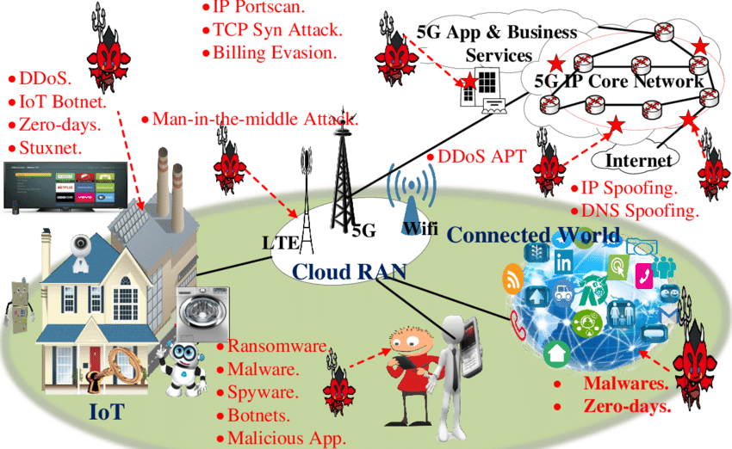
Security Challenges and Vulnerabilities
04
What are the Risks of using this integration?

Slide 17
Security Challenges and Vulnerabilities
Attack types:
Attacker Disrupts the communication channels on the physical layer
Devices connected lose connection
Consequences: Communication breakdown in critical systems that might lead to catastrophes
Attacker impersonates a legitimate 5G station
Devices choose to connect to the fake station because of the better signal
Consequences : Data interception and system manipulation
Jamming Attacks:
Fake Base Station Attacks:

Slide 18
Security Challenges and Vulnerabilities
Attack types:
Attacker Disrupts the communication channels on the physical layer
Devices connected lose connection
Consequences: Communication breakdown in critical systems that might lead to catastrophes
Attacker impersonates a legitimate 5G station
Devices choose to connect to the fake station because of the better signal
Consequences : Data interception and system manipulation
Jamming Attacks:
Fake Base Station Attacks:
Critical Consequence: Industrial disasters and smart traffic system failures with potential catastrophes

Slide 19
05
Research challenges and Projections
What is the gap between theory and practice?
01
02
03
Legacy system integration:
The need to upgrade existing CPS and 5G capabilities to be compatible and reliable
Unifying standards and protocols across devices:
All sensors and controls need to communicate through the same network with no conflicts
Dynamic resource allocation in different environments:
The system must be able to take split-second decisions about resource distribution and prioritizing safety critical vehicle data

Slide 20
Research challenges and Projections
05
Current Technological Limitations:
What is the gap between theory and practice?
01
02
03
Current 5G networks achieve 1 -10 millisecond latency.
Future projection: The latency can be decreased with further research to reach a reliable 1 millisecond latency or less
There is a limited real-world deployment of this type of systems
Future projection:
CPS and 5G integrated systems will be widely implemented in many field of industry
Lack of standards of integration between CPS and 5G
Future projection:
There will be a common standard that will make developing those systems easier

Slide 21
05
THANK YOU!
What is the gap between theory and practice?
Any questions?
Mohamed Amer
Cyber-Physical Systems I
Hochschule Hamm-Lippstadt
Summer Semester 2025

